Slide 1
Applied Data Science Capstone
Peer-graded Assignment

Slide 2
Introduction The Applied Data Science Capstone project was carried out as a requirement for the Coursera-based IBM Professional Certification in Data Science. The research involved using real-world datasets and doing data extraction, cleaning, exploration, and analysis in order to uncover important insights.

Slide 3
Data Collection The practise of obtaining information or data from various sources for analysis and decision-making is known as data collection.
Data collection through Web scraping is available on this github – here
SpaceX api data collection is available on this github - here

Slide 4
Data Wrangling After collecting the data we check the missing data ,and data types and do on of the following to clean the data :
Replace the missing data with one-Using mean or so.
Change data type of the data
Represent categorical data using integer or float dummy numbers -one hot encoding.
Github link - here

Slide 5
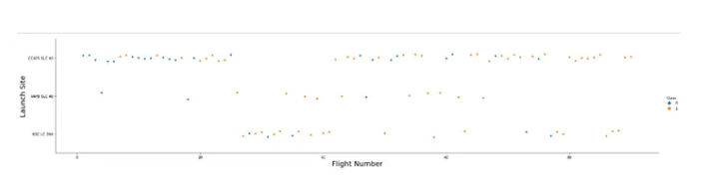
Exploratory Data Analysis After Data cleaning the we can proceed to Analyzing the data using visualization to get some insights of the launches .
Here are some of the screenshots

Slide 6
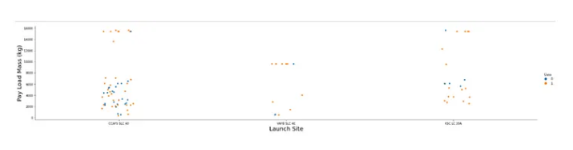
Exploratory Data Analysis From the Visualization we can conclude that:
1,Earlier flights launch were from CCAFS-SLC-40 site ,Followed by KSC-LC-39A 2,Most Launches are Launched from CCAFS-SLC-40 3,Fewer Launches from VAFB SLC 4E site

Slide 7
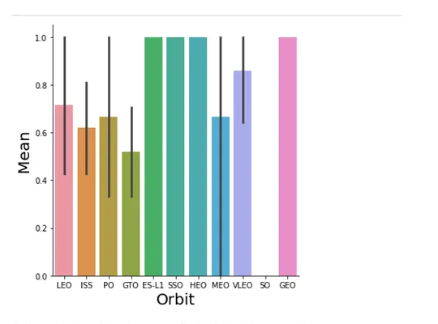
Exploratory Data Analysis From the Visualization we can concluded that:
VAFB SLC 4E has Low Payload launches
CCAFS SLC 40 has more Higher Payload Launches and Low Payload Lauches .

Slide 8
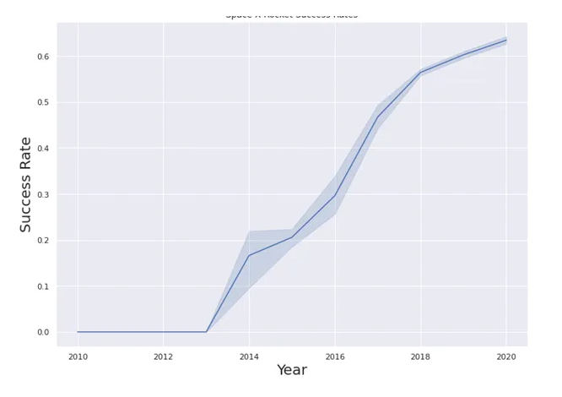
Exploratory Data Analysis Other analysis include Exploratory analysis of data from db2 database using sql statement to get insights here

Slide 9
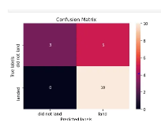
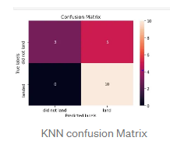
Exploratory Data Analysis We analyze the data and see that their success rate which shows increase in landing success probability .
Predictive Analysis
Using the data I trained the Machine learning models such as: KNeighborsClassifier

Slide 10
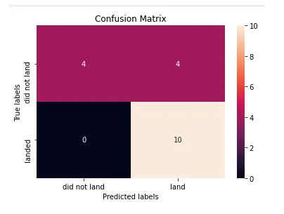
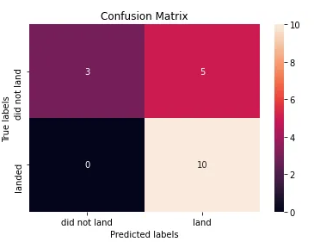
Exploratory Data Analysis Decision Tree classifier Logistic regression

Slide 11
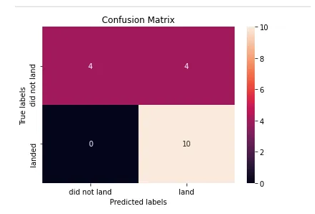
Exploratory Data Analysis Support Vector Machine

Slide 12
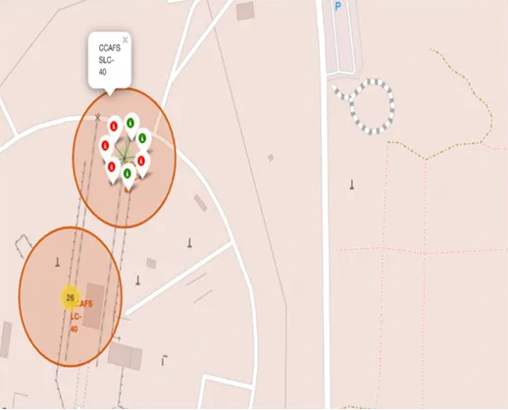
Interactive Map with Folium
Since spaceX launches come from different launch sites I displayed the information of failed and successful launches as a cluster on the map.Through zooming in and out you can obersever the clusters of success lauches and failed launches .

Slide 13
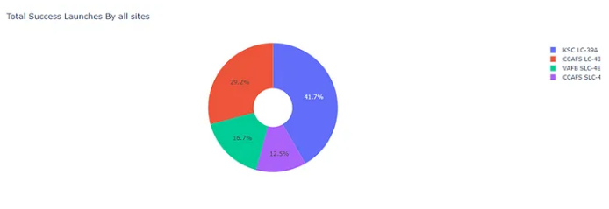
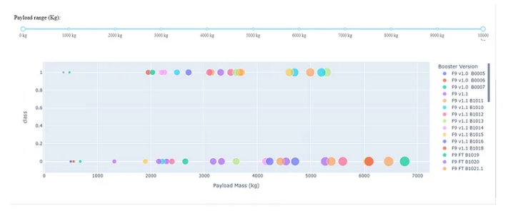
Interactive Dashboard with Plotly Dash
Plotly Dash is Python library that makes it easier to create a dashboard for us as Data Scientist . With a simple interactive dashboard one can change the inputs to see representation of values in graphs .

Slide 14
Results
Most launches were form KSC PAD 39A since most of them were to VLEO,GEO or ISS which makes it a good site to launch from .
Falcon heavy launches mostly to full payload to maximize use of the falcon payload capacity .
Probability of booster landing increases of time by use of the data collected from failing .
SpaceX first successful booster Landing happened on 06/05/2016.

Slide 15
Conclusion
Using Existing Data and Analyzing the data ,SpaceX and other rocket companies can be able to see the best way to reduce the cost of launches,and evolve before there tradition costly launches lead to their absoluteness and losing their client .
You can read my complete detailed report on this link
Github repository for all the notebooks link

Slide 16
THANK YOU

